Slide 1
SHOPPING BEHAVIOUR DATA ANALYSIS USING PYTHON
Presented By:Chitty Sowmya
AF04957531

Slide 2
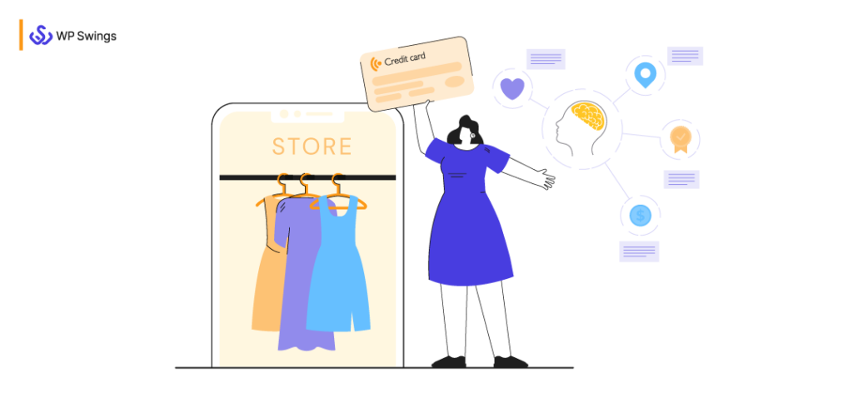
CONTENTS
Overview
Introduction
Code
Outputs
Conclusion

Slide 3

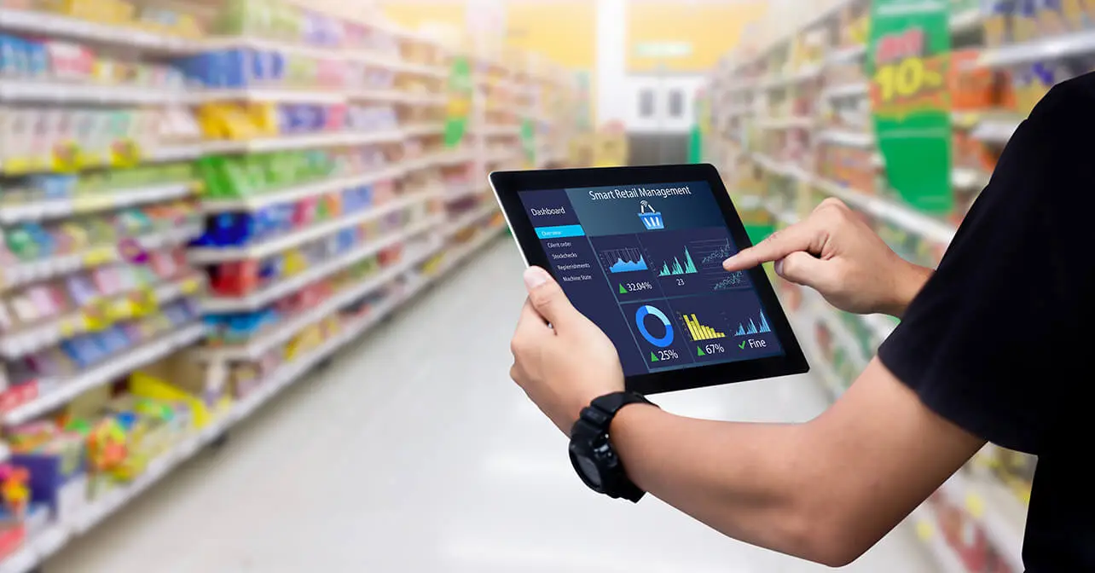
OVERVIEW
This project focuses on analyzing customer shopping behavior to uncover patterns and insights that drive business decisions.
Utilized Python libraries — NumPy, Pandas, and Matplotlib — for efficient data handling, analysis, and visualization.
Explored customer attributes such as age, gender, purchase amount, category preference, and payment method.
Generated multiple visualizations including bar charts, histograms, scatter plots, and pie charts to illustrate spending and demographic trends.
Calculated statistical metrics (mean, median, standard deviation) using NumPy to summarize purchase behavior.
Identified key insights into consumer demographics, spending habits, and popular product categories.
The analysis provides valuable understanding to improve targeted marketing, sales forecasting, and customer engagement strategies.

Slide 4
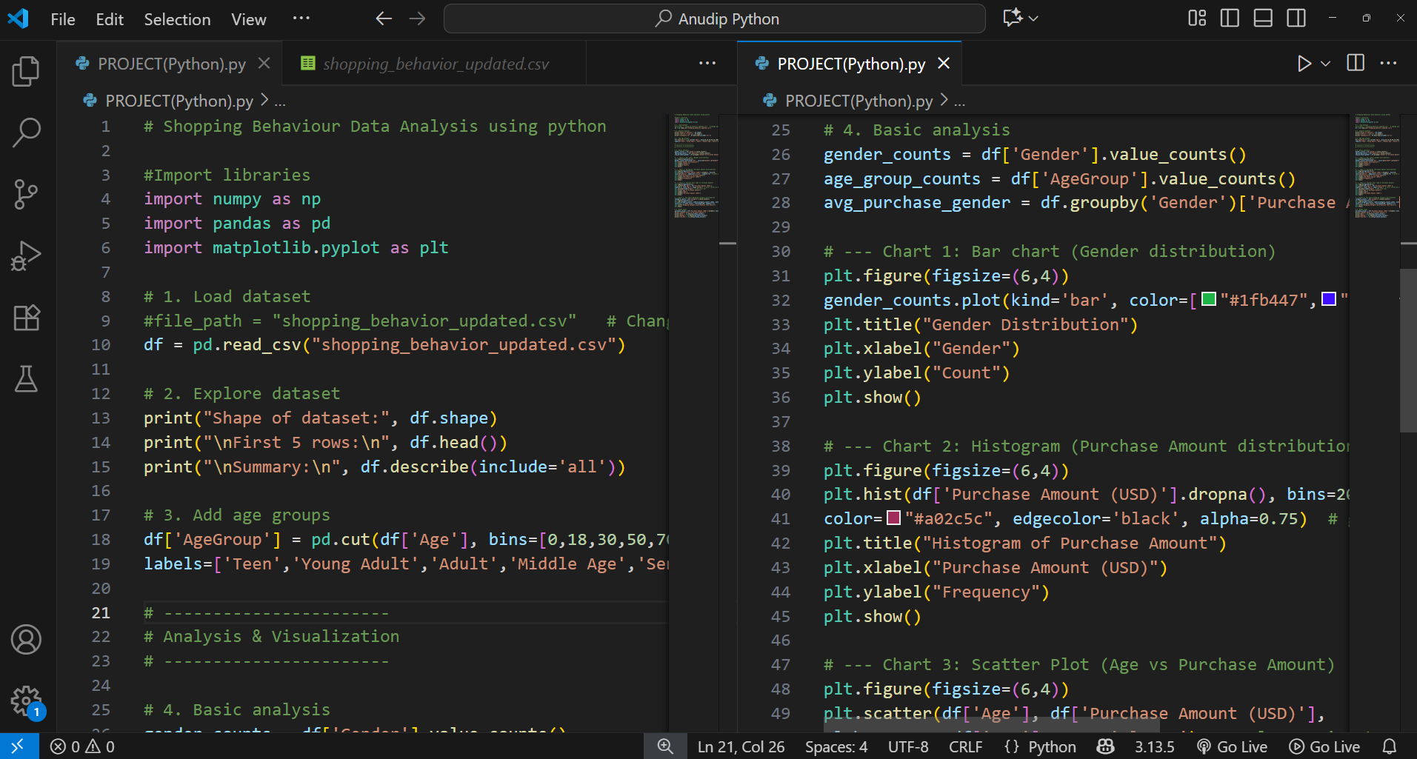
SOURCE CODE

Slide 5
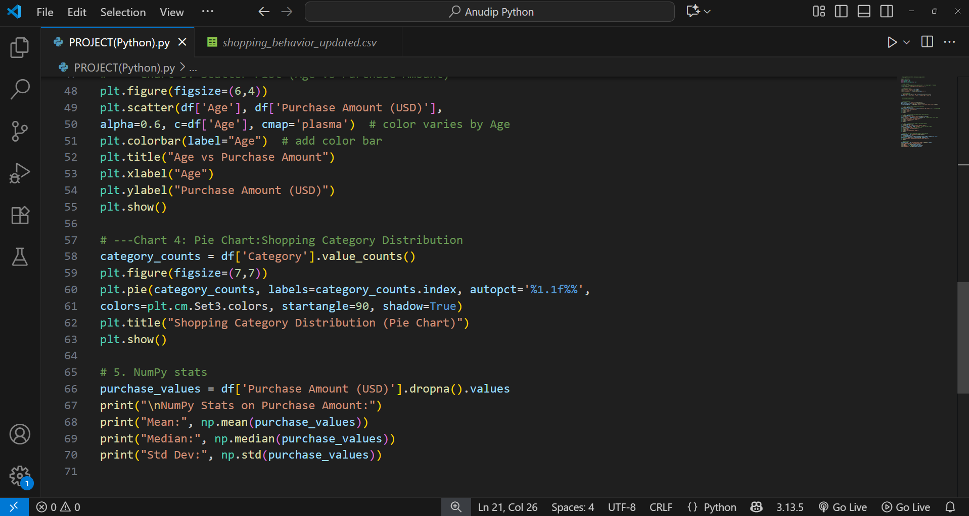

Slide 6
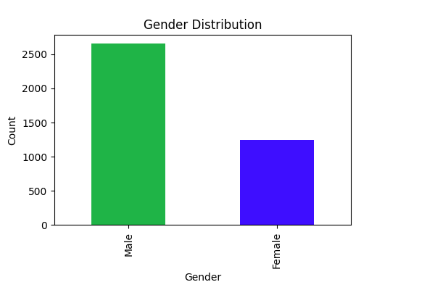
OUTPUTS
Barchart :

Slide 7
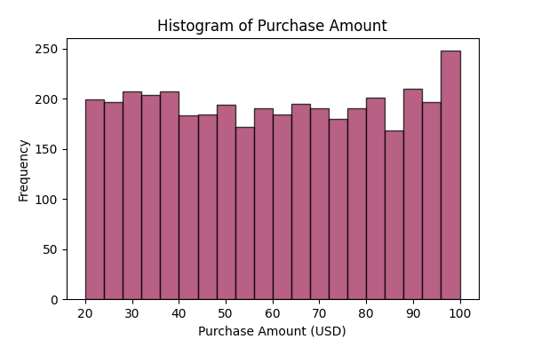
Histogram:
.

Slide 8
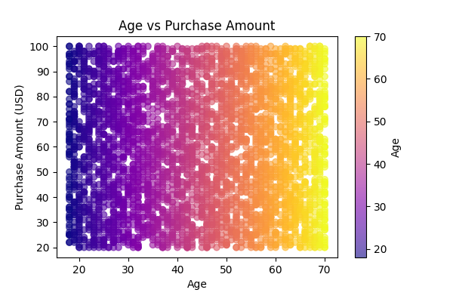
Scatter Plot:

Slide 9
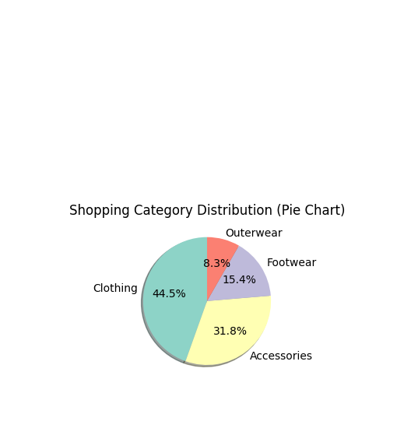
Pie chart :

Slide 10
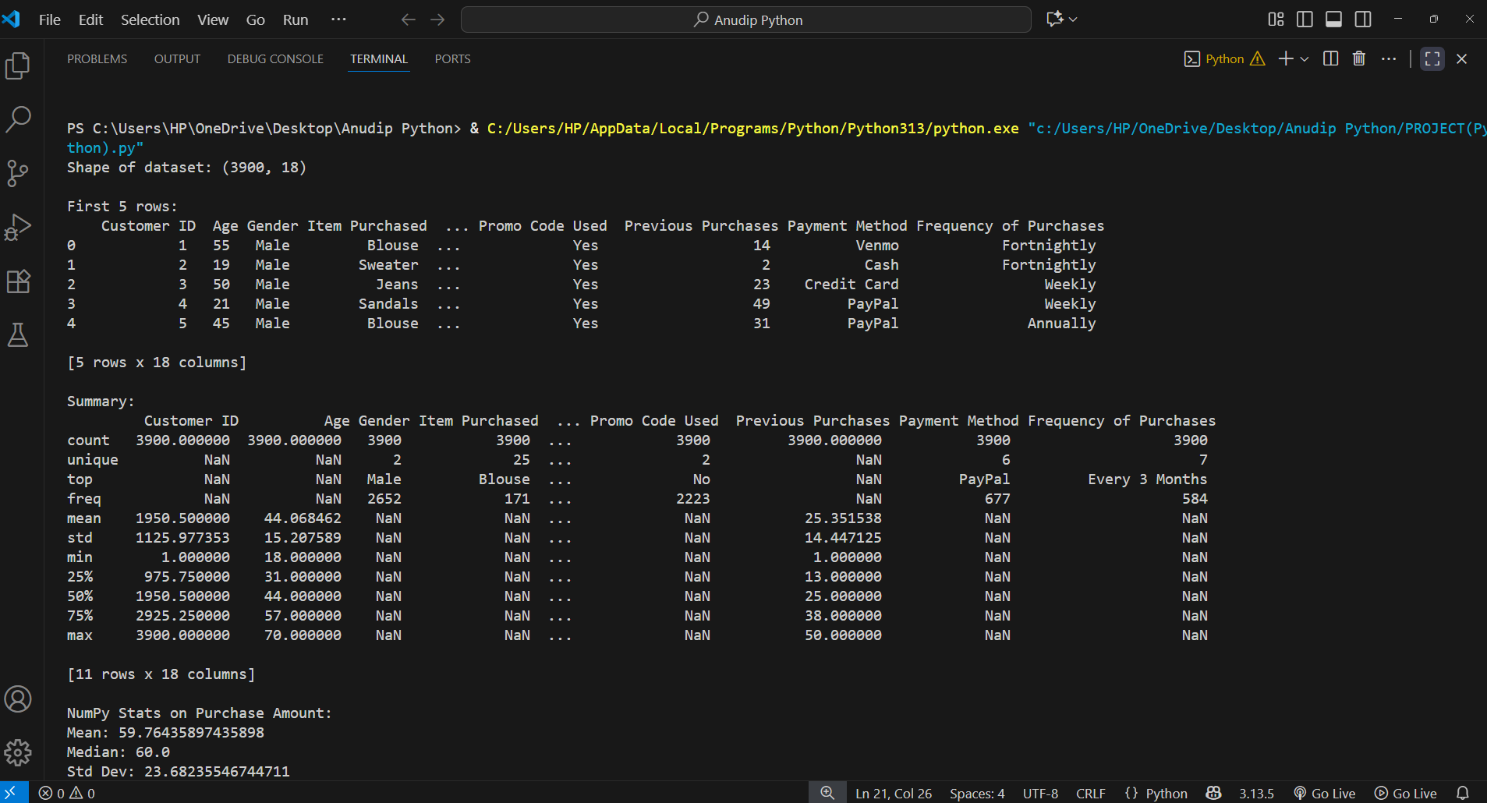

Slide 11
CONCLUSION
The Shopping Behavior Data Analysis project provided valuable insights into customer purchasing trends and preferences.
By analyzing demographic and transactional data, we identified patterns that can help businesses understand their customers better and make informed decisions.
Gender and age play a crucial role in influencing purchase behavior.
Certain product categories show consistently higher demand.
Average purchase amounts and spending variations were identified using NumPy statistics.
Visual analysis through charts made trends easy to interpret and compare.
The findings can guide marketing strategies and improve customer targeting.

Slide 12


